Slide 1
Evacuation Procedures Of Mott’s Regional Technologies Center (RTC)
By: Ian Rencsak

Slide 2
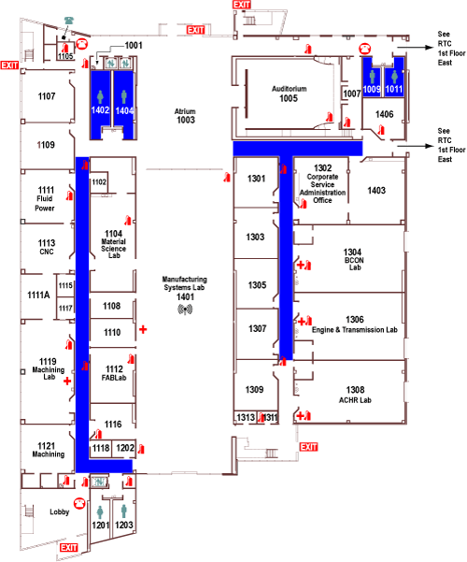
First Floor Layout West-East
Plenty of exits make the building easy to evacuate
Simple floor plan make it easy to navigate

Slide 3
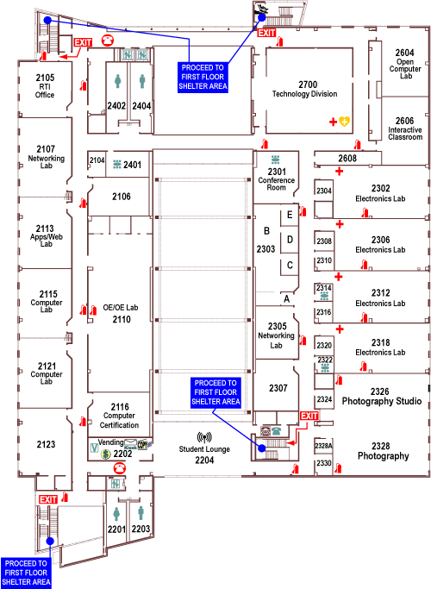
Second Floor Layout

Slide 4
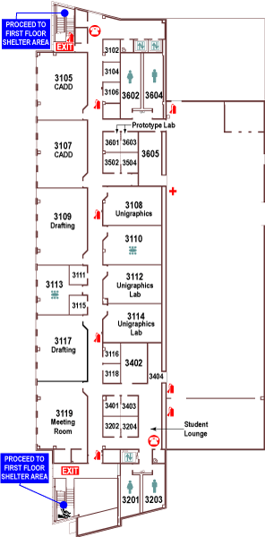
Third Floor Layout and Evacuation Steps
Safely stop your work
Calmly leave the building using the nearest exit
Once safely evacuated wait for instructions from emergency responders

Slide 5
Mott’s Regional Technologies Center Is Prepared
With many easy to find exits, plentiful fire extinguishers and many first aid kits The RTC building seems to be as well prepared for emergencies as any building could be. Mott has done it’s part to help in case of an emergency, now the ball is in your court. Remember to keep calm and always have safety as a first priority.

